Slide 1

MID GRAD CAPSTONE PROJECT 2
B Uday Kumar Reddy-2000040020
P Shashikanth Reddy-2000040108
B Likith Vishvendra-2000040199

Slide 2
Our Project
VENDING MACHINE USING VERILOG

Slide 3
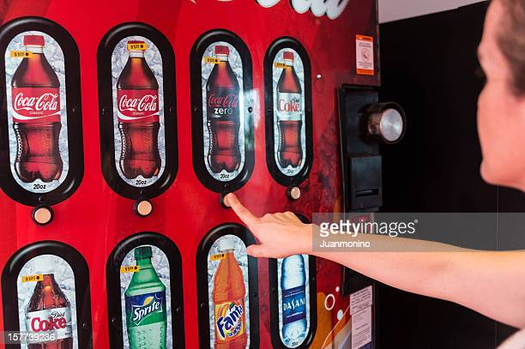
.
PROBLEM STATEMENT
As day by day technology is boosting rapidly so automation is playing a major role.
So we can buy the things automatedly by using vending machines.
So for these automation we are doing this project .

Slide 4
INTODUCTION
The vending machine is an automated machine that dispenses various products such as snacks, beverages, newspapers, tickets etc to customers when money is inserted.
Vending machines are more accessible and practical than the convention purchasing method Now, vending machine market is a big business with huge annual revenue for leading nations.
The machines usually work when a product is selected and some money (usually coins or paper money) is put in a slot. Then, a button needs to be pushed, or a lever pulled. If there is enough money, the selected item will be dropped to a tray, where it can be taken out by the person making the purchase.

Slide 5
LITERATURE SURVEY
In Vending Machines in Australian Hospitals: Are They Meeting the Needs of the Consumer?[2021]
This paper explores how well vending machines are meeting the needs of health care organizations and their staff and visitors in Australia.
In Snackomat - A Vending Machine To Create Positive Experiences By Bringing People In Contact And Initiating Small Talk In Waiting Situations[2020].
In this paper, "Snackomat" is a vending machine offering snacks for free, installed in waiting situations, and is designed to initiate small talk and therewith create a positive experience.
These are some literature surveys which proves that vending machines are playing a major role in our lives.

Slide 6
SHORTCOMINGS OF EXISTING WORK
Even through Vending Machines became most important in our life we identified that their working speed is slow.
And due to these reasons still mostly we are not using the Vending Machines.
So Vending Machines should speed up by inserting new technologies into them.

Slide 7
PROPOSED METHODOLOGY
The project aims to design a vending machine that can dispense soft drinks of different prices, it accepts all the coins i.e.: 5 Rupees,10 Rupees, 20 Rupees and 50 Rupees.
Till it receives 10 Rupees it will not dispense anything. After it has received 10 Rupees it will dispense a soft drink. Any amount above that will be given back as a change.
The finite state machine (FSM) approach is adopted for the design of vending machine. The design is achieved by formulating the Verilog code for the FSM-based machine using behavioural and simulated in the XILINX (VIVADO). simulating the testbench for the products.

Slide 8
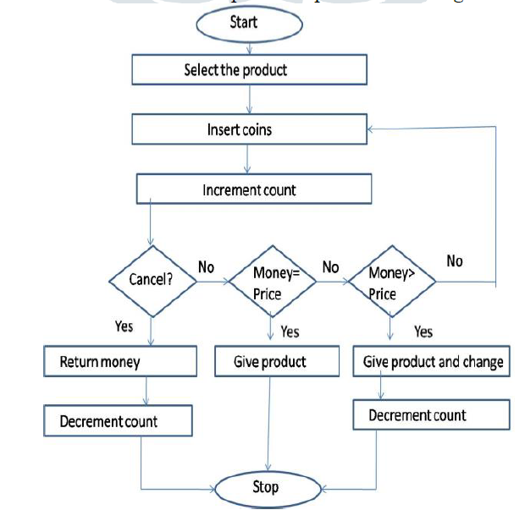
.
FLOW CHART
.

Slide 9
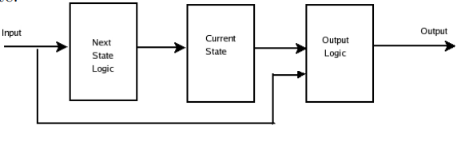
The modelling of the Finite State-based Vending Machine using the mealy model.
Mealy Finite State Machine:
If the next state of the system depends on both the present state and the present input, then it is called a Mealy Finite State Machine.
Here we are using the mealy finite state machine.

Slide 10
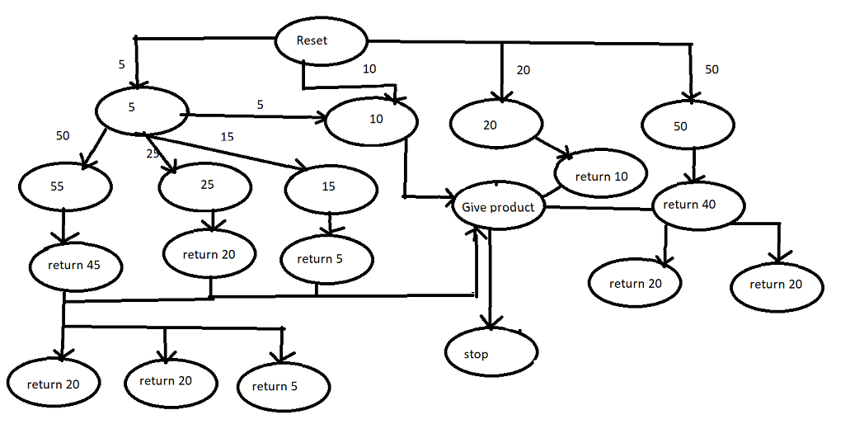

Slide 11
DESCRIPTION
Here we have the first state that is reset state, if less amount is provided or non acceptable amount is provided then it will come back to reset state.
Also if we provide amount 5,10,20 and 50 based on that it moves into further state ,gives product and return extra amount.
The amount that will return also same 5,10,20 and 50 rupees as it want to return 45 rupees then it will return as 20,20 and 5 rupees.

Slide 12
CODE EXPLANATION
Here for code we are taking only 3 states so that code complexity get decreases and well understandable .
State 0→Represent the reset state(rupees 0)
State 1→Represents the State 1(rupees 5)
State 2->Represents the state 2(rupees 10)
Out->to show whether we get product or not
In->based on this input we move from 1 state to other(amount)
Change->amount left after providing the product
Here we are providing product when it reaches 15 rupees
Firstly reset is 1 and clock is zero then both out and Change are 0
When reset is 0 and clock is On then it starts taking the input(in)

Slide 13
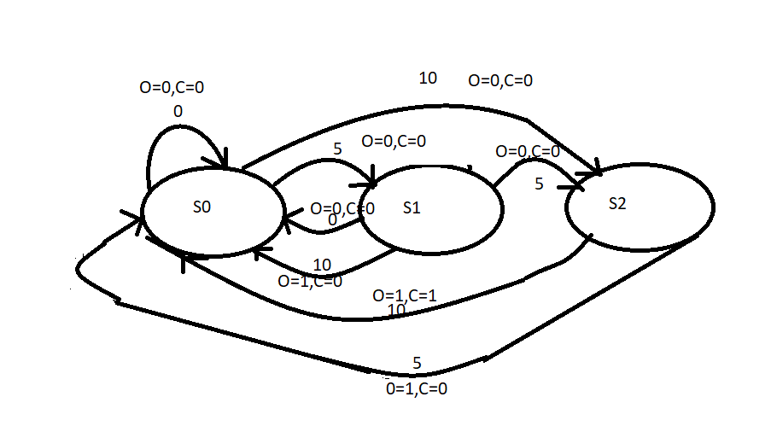

Slide 14
When we are at State 0 :
If given input 0->it will be in the same state, out is 0, change is 0
If given input 1->it will move to state 1, out is 0, change is 0
If given input 2->it will move to state 2, out is 0, change is 0
When we are at State 1:
If given input 0->it will be in the same state, out is 0, change is 0
If given input 1->it will move to state 2, out is 0, change is 0
If given input 2->it will move to state 0, out is 1, change is 0
When we are at State 2:
If given input 0->it will be in the same state, out is 0, change is 0
If given input 1->it will move to state 0, out is 1, change is 0
If given input 2->it will move to state 0, out is 1, change is 1

Slide 15
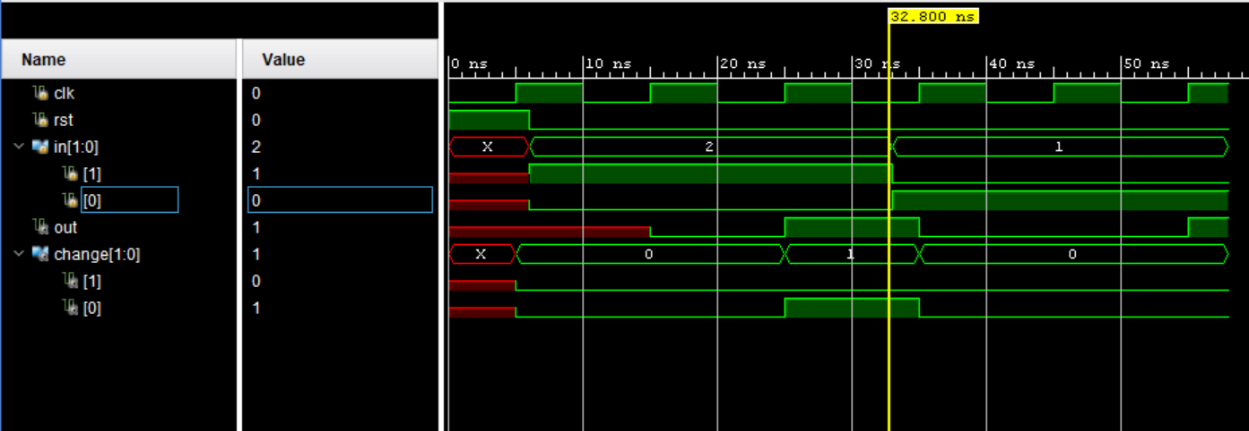
RESULT

Slide 16
CONCLUSION
The vending machine was successful in dispensing products when required amount is inserted into it.
Also, with the additional features of dispensing product along with returning change when amount is inserted and returning total money when request is cancelled.
The vending machine is successful in meeting the specifications laid out prior to the design.
Our further plan of action is to implement this project on fpga boards and make vending Machine use everywhere.

Slide 17
Thank You

